Slide 1
Best practices and learnings for scaling biomass processing – examples from the MarginUP! project
Karen Hamann
Biosolutions Scale Up Symposium
March 18, 2026

Slide 2
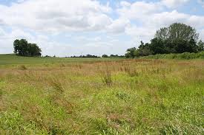
Use Cases in 5 EU countries, Argentina, South Africa
Pilot-scale processing of the biomass
Test biomasses in biobased products
2022-2026, Funded by EU (Horizon Europe RIA)
28 partners
MarginUP: Growing feedstocks for
biobased products on marginal land

Slide 3
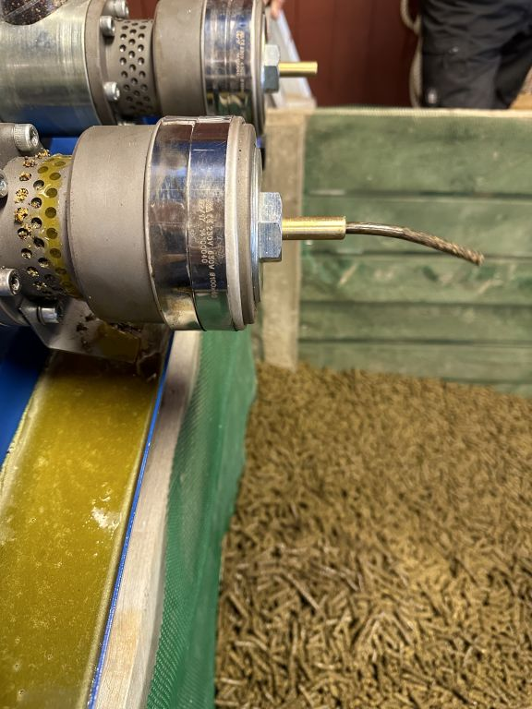
Sweden: Turnip rapeseed for biodiesel
Success factors:
Working biodiesel plant - container scale
Batch biodiesel productions completed
Known technology for making press cakes
Market demand for biodiesel
Main challenges:
Logistics – transport of rapeseed or processing equipment?
Drying of rapeseed required due to climatic conditions
Technologies work - what are the right scales?

Slide 4
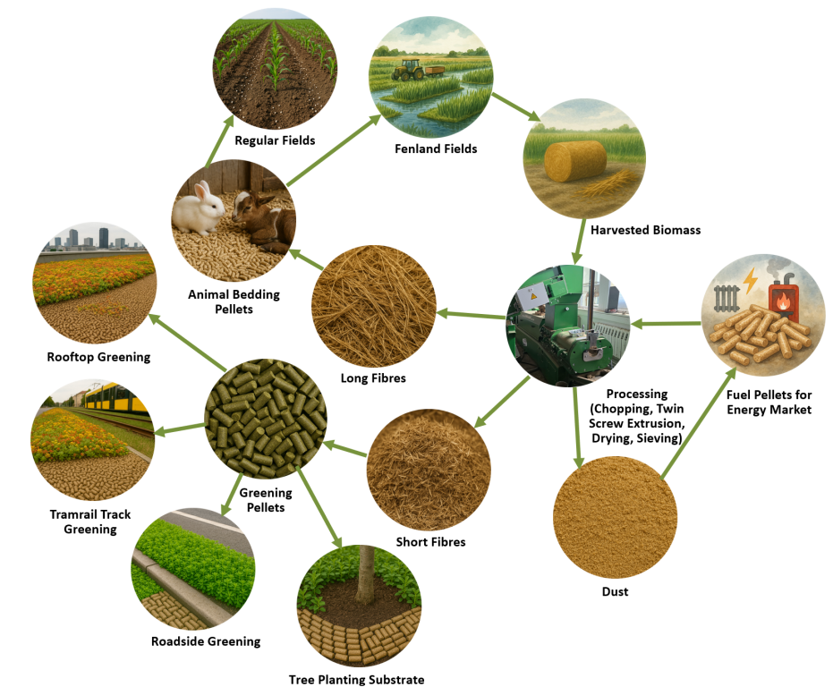
Germany
Paludi-culture for pellets and energy

Slide 5
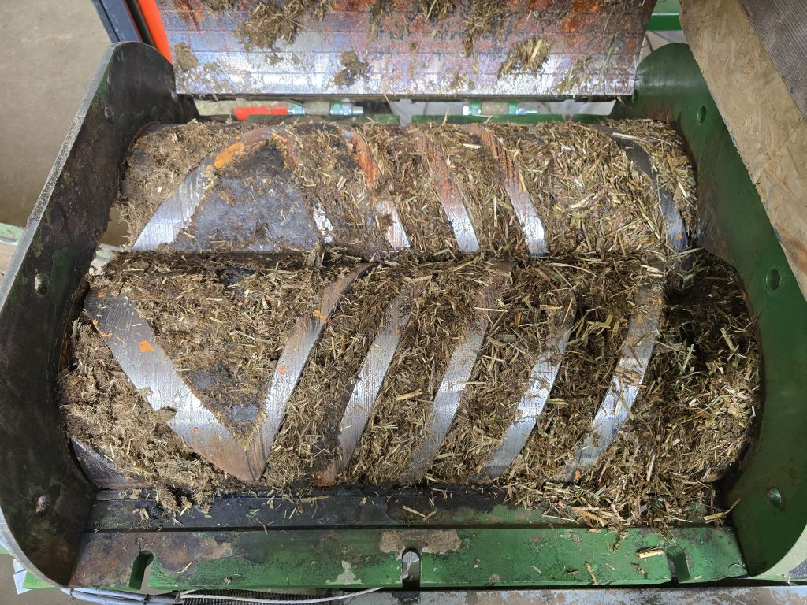
Germany: Paludiculture for growth substrates
Success factors:
Adaptation of twin-screw extrusion technology
Adapt a moisture control system
Development of a marketable growth substrate
Main challenges:
Extruder in pilot-scale only
Funding for industrial scale extruder for an early-stage product
Biomass quality management
From R&D to
commercial entity

Slide 6
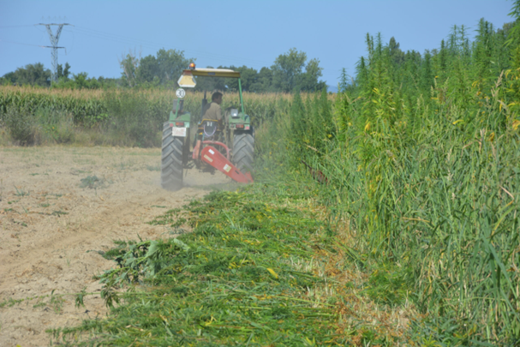
Spain: Hemp for precast panels
Success factors:
Known fiber separation technology
Fiber application in precast panels demonstrated
Tobacco company looking for new opportunities
Main challenges:
Fiber processing in pilot scale
Limited supply of local hemp crop
Processing of long fibers not yet considered
Known technologies
Unsolved biomass production and valorisation

Slide 7
Lessons learned
Good practices
Consider all operations from field to biobased product to find the relevant scale
Feedstock availability and logistics important for organizing biomass processing scale
Adapting known technologies to new types of feedstocks makes the route to market faster – for all parties
Look beyond “local” – the feedstock or market may be somewhere else
Crop easy to implement in local agricultural production => faster scale up of feedstock production
Find marketable applications for main fractions of the biomass
Connect with end-user early to adapt processing to industrial need (e.g. quality)
Prioritize what could make a good business case

Slide 8

Karen Hamann
IFAU Institute for Food Studies &
Agri Industrial Development ApS
Denmark
karen@ifau.dk

